Slide 1
Longest Common Pattern between Two Permutations
Mathilde Bouvel and Dominique Rossin
Pure Mathematics and Applications, To be published, 2007
Presenter: Chiou-Ting Tseng
Date: Feb. 14, 2008

Slide 2
Abstract
In this paper, we give a polynomial (O(n⁸)) algorithm for finding a longest common pattern between two permutations of size n given that one is separable. We also give an algorithm for general permutations whose complexity depends on the length of the longest simple permutation involved in one of our permutations.

Slide 3
You Know
這張投影片要講的就是這個嘛You know!
當你想要講You know的時候通常就代表 I don’t know how to explain
在準備投影片的時候一定要確定在講you know之後人家回答”No, I don’t know”還是要能夠很快的把東西說明清楚

Slide 4
Outline
Introduction
Separating Tree
Common Interval Decomposition
Method
Conclusion

Slide 5
Pattern
A permutation π = π₁ . . . π_{k} is called a pattern of the permutation σ = σ_{i+1} . . . σ_{i+n} of I = {h : i + 1 ≤ h ≤ i + n}, with k ≤ n, if and only if there exist integers i + 1 ≤ i₁ < i₂ < . . . < i_{k} ≤ i + n such that σ_{iℓ} < σ_{im} whenever π_{ℓ} < π_{m}. We will also say that π is involved in σ or that σ contains π. The subsequence σ_{i1}σ_{i2} . . . σ_{ik} is called an occurrence of π in σ.
i = 2, n = 5, σ= 37465

Slide 6
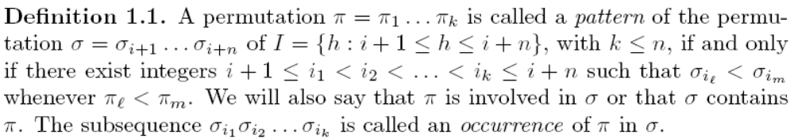
Pattern
σ= 473165892, k=4
i+1
i₁
i₂
i₃
i₄
i+n
π=3124 → π₂< π₃< π₁< π₄ →When i₁=2, i₂=3, i₃=6, i₄=8
→σ =7359→σ_{i1}< σ_{i3}< σ_{i2}< σ_{i4}

Slide 7
Example
σ = 1 4 2 5 6 3 contains the pattern 1 3 4 2 and 1 5 6 3, 1 4 6 3, 2 5 6 3 and 1 4 5 3 are the occurrences of this pattern in σ.
But σ avoids the pattern 3 2 1

Slide 8
Previous Work
The problem of deciding if a permutation π is a pattern of a permutation σ is NP−hard but this problem is proved to be polynomial if the pattern is separable.
Counting the number of pattern matching in permutations in O(kn⁴) time and O(kn³) space[Ibarra93].

Slide 9
Outline
Introduction
Separating Tree
Common Interval Decomposition
Method
Conclusion

Slide 10
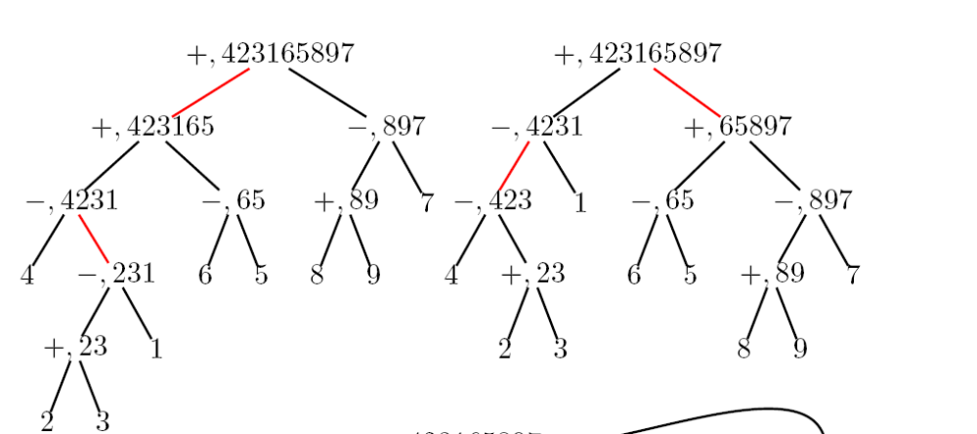
Decorated Binary Separating Tree

Slide 11
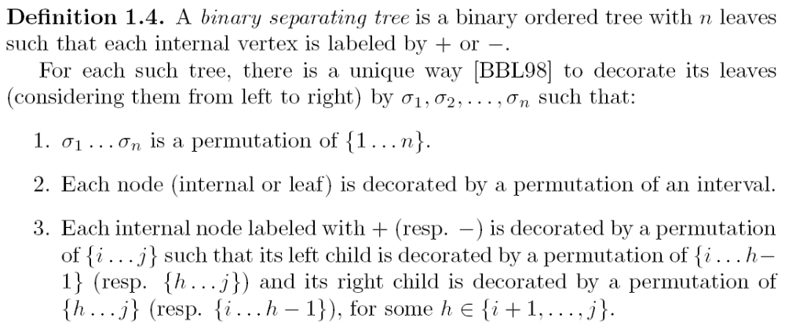
Decorated Binary Separating Tree

Slide 12
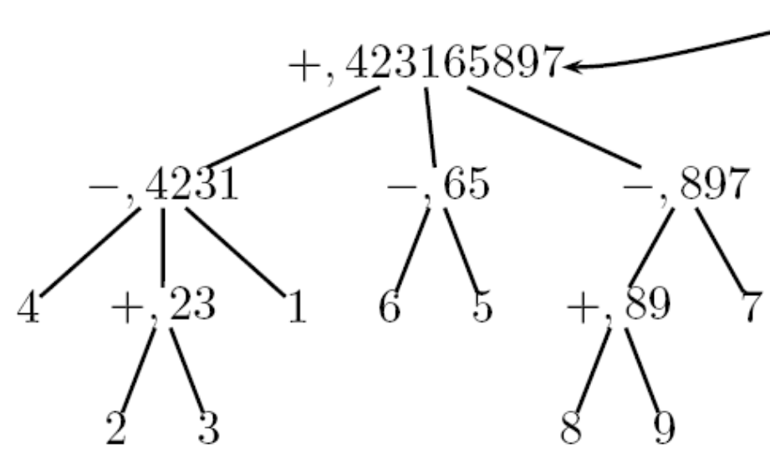
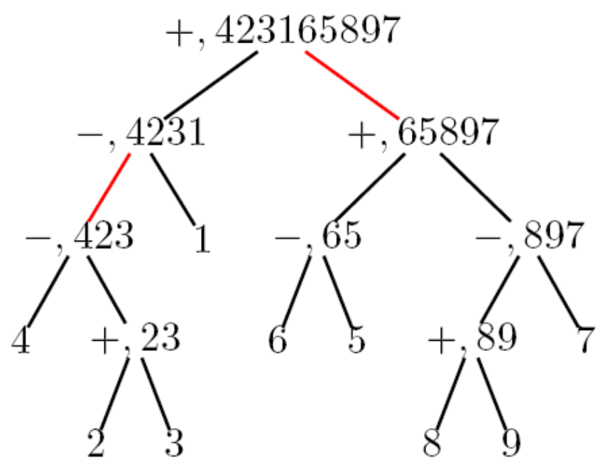
Decorated Contracted Binary Separating Tree

Slide 13
Separable
A permutation σ of size n is called separable if it avoids the patterns 3 1 4 2 and 2 4 1 3 or equivalently if it has a binary separating tree.
There is no direct way to calculate the binary separating tree.

Slide 14
Outline
Introduction
Separating Tree
Common Interval Decomposition
Method
Conclusion

Slide 15
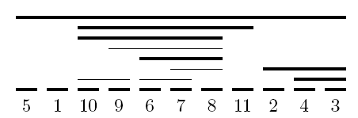
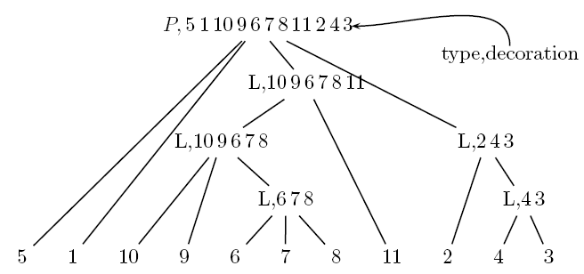
Common Interval Decomposition

Slide 16
Common Interval Decomposition Tree
Calculated in linear time[Ber05]

Slide 17
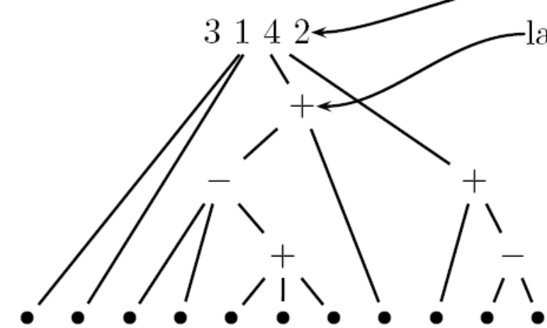
Labeled Decomposition Tree
5 1 10 9 6 7 8 11 2 4 3
Calculated in O(n²logn)
by sorting the intervals

Slide 18
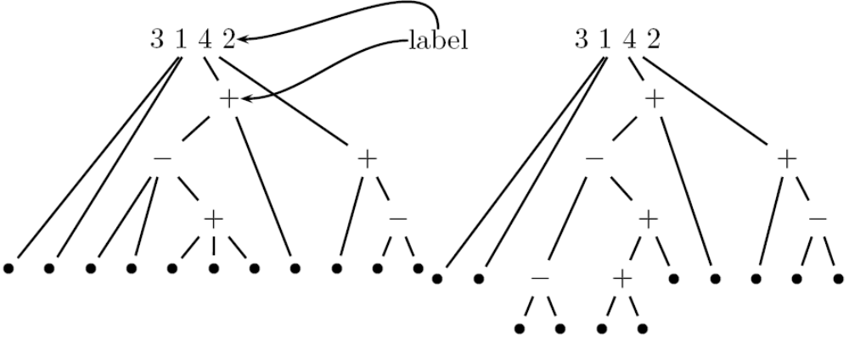
Expanded Decomposition Tree
5 1 10 9 6 7 8 11 2 4 3
5 1 8 11 2 4 3
10 9 6 7

Slide 19
Expanded Decomposition Tree
For any separable permutation, its contracted separating tree and its labeled decomposition tree are equal.
4
1
6
5
7
(沒有數字)
2
3
8
9

Slide 20
Outline
Introduction
Separating Tree
Common Interval Decomposition
Method (Dynamic Programming)
Conclusion

Slide 21
Problem Definition
Input: A permutation τ and a binary separating tree T_{σ} transformed from a separable permutation σ.
Output: Longest common permutation of τ and σ.
Method: Dynamic programming.

Slide 22
Matrix
M = {M(V, i, j, a, b) : V a node of T_{σ}, 1 ≤ i ≤ j ≤ n, 1 ≤ a ≤ b ≤ n}.
以V為root的subtree跟τ[i,j]中值是[a, b]的longest common permutation
If the node V represents the pattern 2 1 (i.e. σ(V ) = (i +1) i), and τ = 6 4 2 5 3 1 then we have for instance M(V, 2, 4, 3, 5) = 1, M(V, 2, 5, 3, 4) = 2 1 and M(V, 4, 5, 1, 2) = ε.

Slide 23
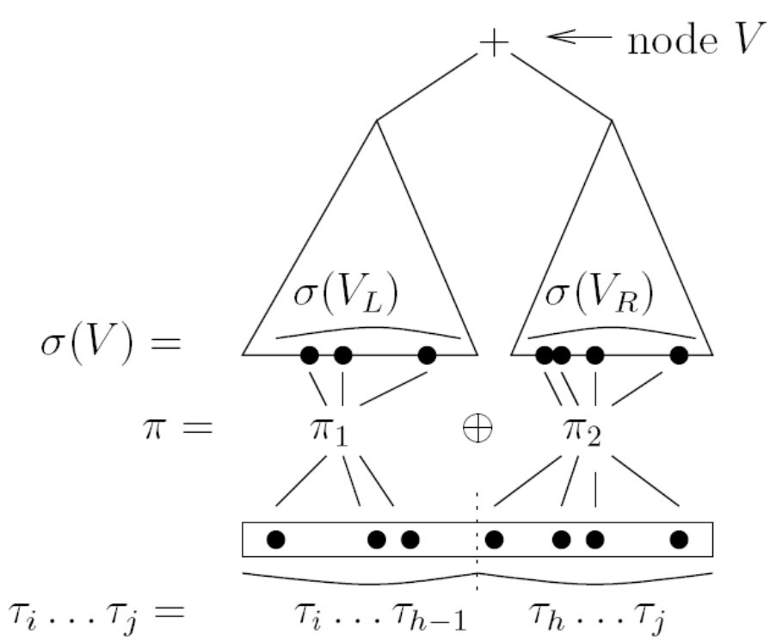
Dynamic Programming

Slide 24
Concatenation
4 3 5 2 1 ⊕ 3 1 4 2 = 4 3 5 2 1 8 6 9 7
4 3 5 2 1 ⊖ 3 1 4 2 = 8 7 9 6 5 3 1 4 2

Slide 25
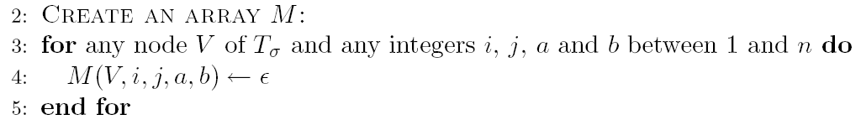
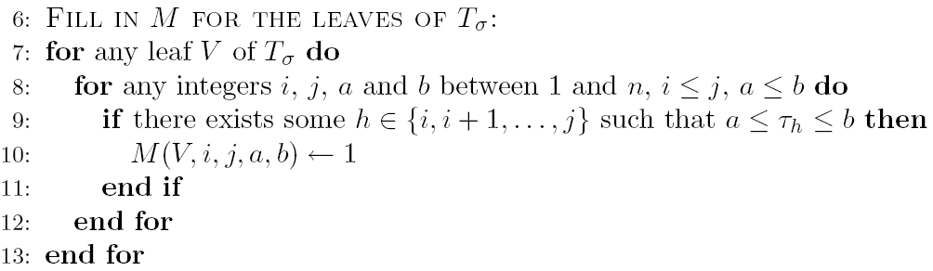
Program
O(kn⁴) time, O(kn⁴) space
O(kn⁵) time

Slide 26
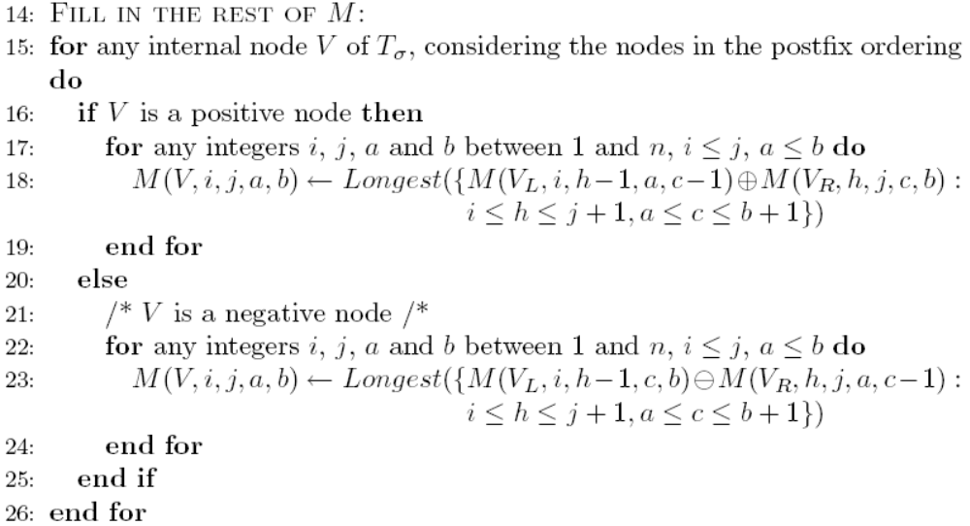
Program
O(min(n, k)n²) time, O(min(n, k)) space
total: O(min(n, k)n²kn⁴) time, O(min(n, k)kn⁴) space

Slide 27
Improvement
This complexity can be improved to O(kn⁶), storing an integer, a label (⊕ or ⊖), and two pointers in M(V, i, j, a, b) (when V is an internal node) instead of a pattern. Namely, if algorithm 1 fills in M(V, i, j, a, b) with the pattern ρ= M(V_{L}, i, h − 1, a, c − 1) ⊕ M(V_{R}, h, j, c, b), it is sufficient to store in M(V, i, j, a, b) the length of ρ, the label ⊕, and two pointers pointing to the entries M(V_{L}, i, h−1, a, c−1) and M(V_{R}, h, j, c, b) of the array M. At the end of the algorithm, this system of pointers gives a binary separating tree of a longest common pattern π between σ and τ. From this tree, π can be computed in linear time.

Slide 28
Fixed Arity
If we consider classes of permutations such that the arity of any prime node in their expanded decomposition tree is bounded by a constant d, algorithm 2 has a time complexity O(min(n, k)kn^{2d+2}).

Slide 29
The Longest Common Permutation Problem
Wei-Fu Lu
NCS2007

Slide 30
Dynamic Programming
For every node V of T_{σ}, 1 ≤ i ≤ j ≤ n, and 1 ≤ x ≤ n, let S_{ML}(V, i, j, x) be the set of longest common permutations in the match of V into (τ_{i}, ... , τ_{j}) with every matched element of (τ_{i}, ... , τ_{j}) ≤ x. Define L(V, i, j, x) = max {0} ∪ {y: y is the smallest matched element of m in S_{ML}}, and M_{L} (V, i, j, x) = the longest common permutations in S_{ML} with the smallest matched element is L(V, i, j, x).

Slide 31
想法
對每組M(V, i, j, x)紀錄兩個東西: 1. 每個元素都≥x的最長common permutation, 2.每個元素都≤ x的最長common permutation
|M_{L}(V_{l}, i, k-1, x-1)| + |M_{H}(V_{r}, k, j, x)|

Slide 32
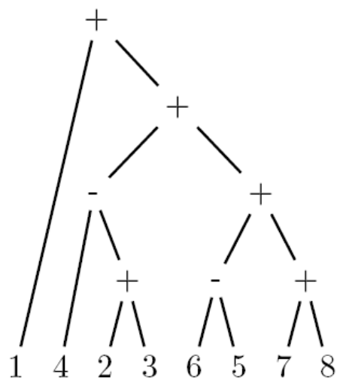
Example
σ=14236578
τ=413256897
i=2, j=7, a=2, b=8
V=4236578, V_{L}=423, V_{R}=6578
h=5, c=4
M(V_{L}, i, h−1, a, c−1)=(423, 32)=21
M(V_{R}, h, j, c, b)=(6578, 568)=123
M(V, i, j, a, b)=21345

